Slide 1




SEM 6 MINI PROJECT
TEAM MEMBERS:
Nidhi R Kudalkar (55)
Tejal G Madvi (57)
Shivkanya U Mahajan (58)

Slide 2
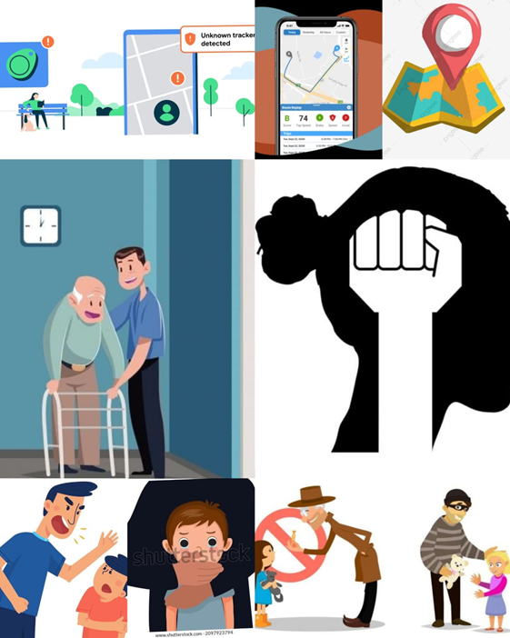
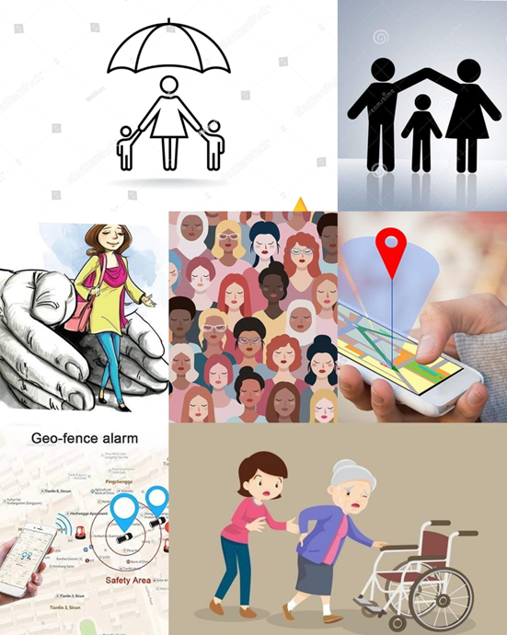
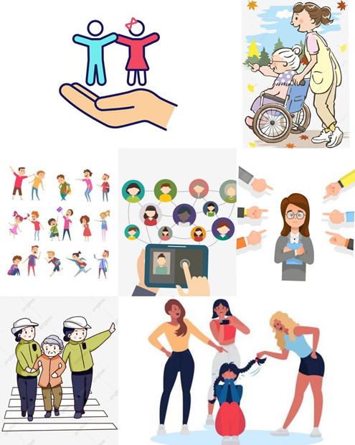
SAFETY TRACKER

Slide 3


ABSTRACT
In today's world, personal safety is of utmost importance, and our app aims to provide peace of mind to users by offering a comprehensive set of features and functionalities. A Safety Tracker is an advanced digital system designed to enhance safety monitoring and incident management across a wide range of environments, including workplaces, public spaces, transportation, and personal safety. Leveraging cutting-edge technology, real-time data analysis, and user-friendly interfaces, Safety Tracker offers a comprehensive solution to identify, respond to, and prevent safety risks effectively.

Slide 4
PROBLEM STATEMENT
Create a safety tracker app that meets the growing concern for personal safety in a variety of scenarios, including urban surroundings, outdoor activities, and office settings. The program should enable users to manage their safety more proactively by delivering real-time location tracking, emergency alerting, and safety-related information while maintaining user privacy and data security.

Slide 5
INTRODUCTION
•Our Safety Tracker App is a powerful and reliable tool designed to ensure the safety and security of individuals, with a particular focus on women, children, and senior citizens.
•The primary function of the Safety Tracker App is to help users stay connected with their loved ones, provide assistance during emergencies, and offer valuable safety resources.
•Through real-time GPS tracking, panic buttons, community reporting, and safety tips, the app empowers users to navigate their daily lives with greater confidence and security.

Slide 6
INTRODUCTION
•Our Safety Tracker App represents a significant step towards prioritizing personal safety and security for women, children, and senior citizens.
• The app's comprehensive set of features, including real-time GPS tracking, panic buttons, geo-fencing, community reporting, and safety resources, empowers users to navigate their daily lives with greater confidence and peace of mind.
•By utilizing our Safety Tracker App, users become part of a supportive network dedicated to enhancing safety and security for everyone.

Slide 7
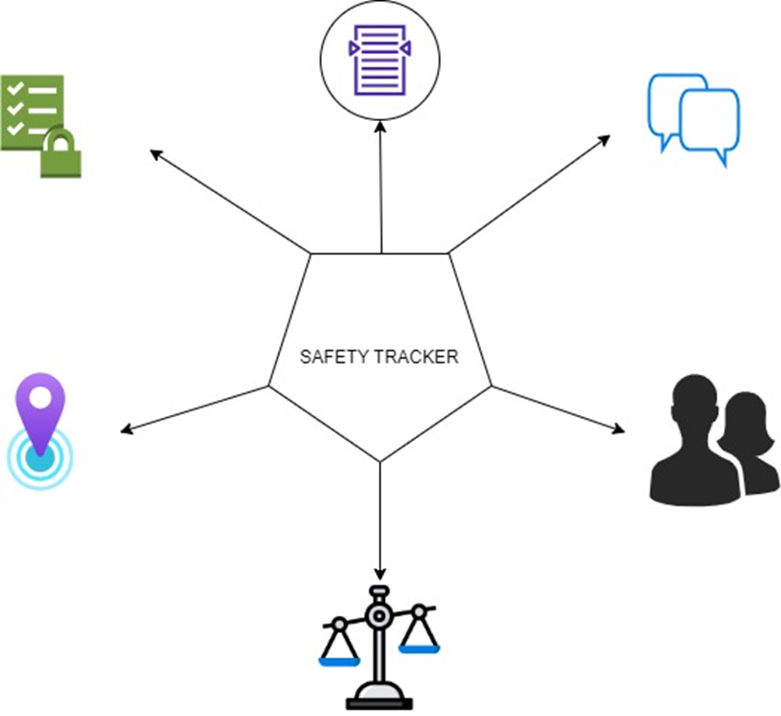
FEATURES
1. Real-Time GPS Tracking
2. Panic Button for Instant Help
3. Emergency Dials and Contact info
4. Community Reporting
5. Safety Tips and Resources
6. Accessibility and Ease of Use
7. Privacy and Security

Slide 8
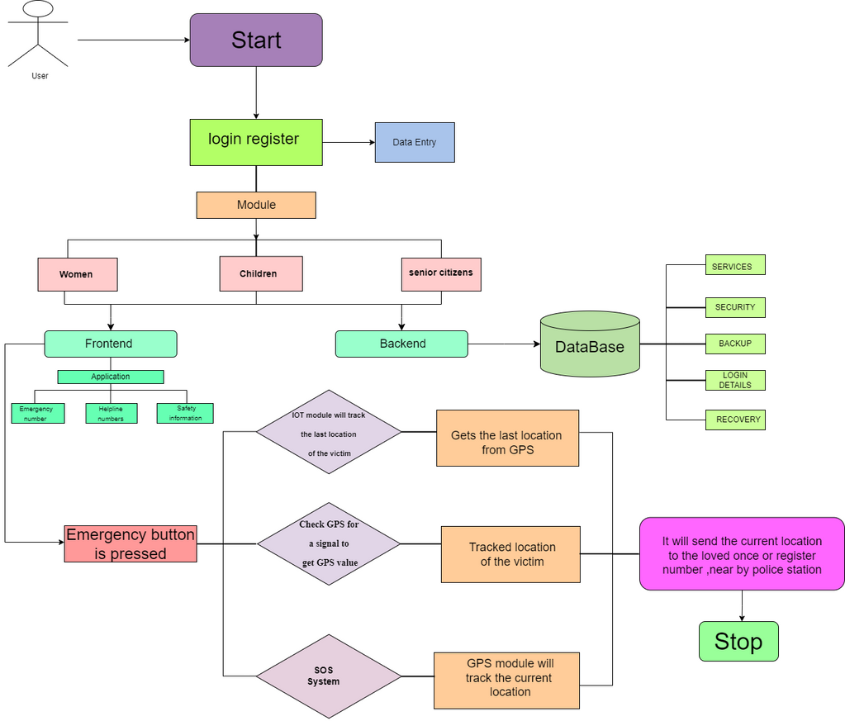
SYSTEM ARCHITECTURE

Slide 9
CONCLUSION
The proposed safety device aims at proving complete security to children, women and old people in current scenarios. To provide comprehensive security, buzzer is included in the design, so that any nearby person gets alerted about the mis-happening. Sending text messages ensure that close relatives and police gets alerted with the current location of victim. Besides, the hardware based design, an android application is developed to provided additional safety features like sending group messages, audio recording and identifying nearby safe location in map.

Slide 10
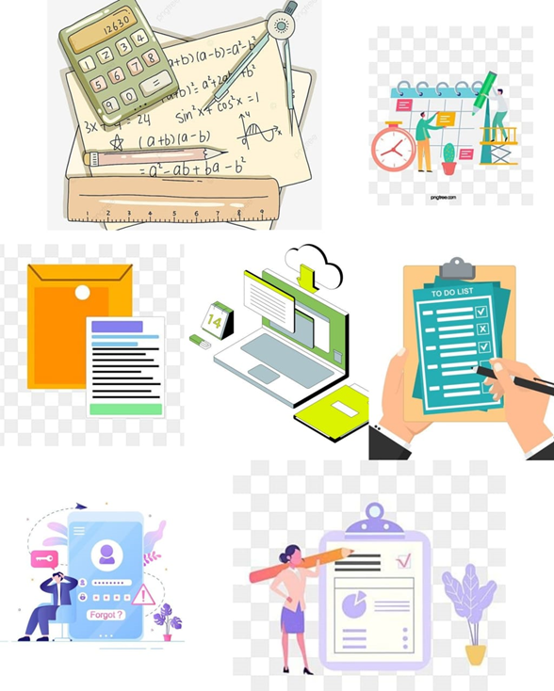
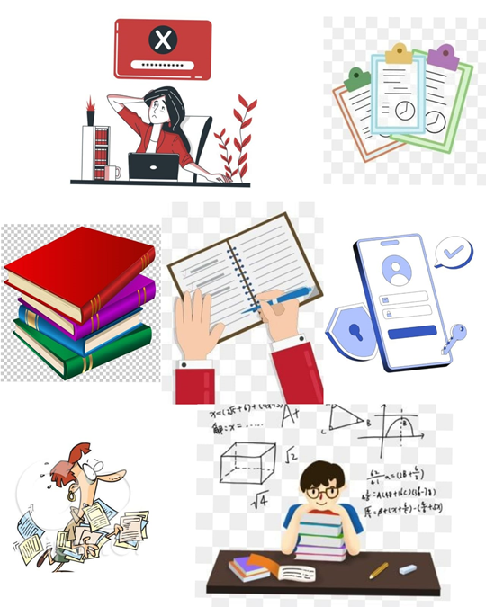

PERSONAL RECORD SYSTEM(PRS)

Slide 11
ABSTRACT
A Personal Record System is a comprehensive software application designed to empower individuals in effectively managing their essential information across diverse aspects. By offering a secure and intuitive platform, this system facilitates the organization, storage, and retrieval of critical data such as notes, documents, and goals. Whether tracking academic achievements , streamlining daily tasks, or safeguarding vital credentials, the system provides users with a centralized and user-friendly interface. The system seeks to enhance productivity, promote goal attainment, and simplify the complexities of modern life.

Slide 12
PROBLEM STATEMENT
Create a comprehensive Personal Record System (PRS) that allows individuals to manage and access their personal, educational, and professional data in a safe and efficient manner. While prioritizing data privacy and security, the PRS should provide a consolidated and user-friendly platform for storing, managing, and retrieving sensitive information.

Slide 13
INTRODUCTION
•A Personal Record System is a software application designed to help the students to efficiently manage and organize their personal and school-related information.
• It provides a centralized platform for storing, retrieving, updating, and analyzing various student documents and notes.
•PRS is a useful software for students since it creates an account where they can safely keep all of their daily work and assignments as well as all of their passwords and essential documents.
•One can create an account and save all of their data in it. It is designed to help students manage their personal academic information, including notes, passwords, and documents.

Slide 14
INTRODUCTION
•This type of system empowers students to keep track of their educational materials and important data in a secure and organized manner.
•The main objective of this project is to simplify students' work by organizing all essential documents into a single folder. This saves time and effort while searching for documents repeatedly.
•In the digital age of education and collaborative project work, an efficient and secure information management solution is essential for students to excel in their academic endeavors.
•This innovative system streamlines the student experience, enabling them to focus on their studies and projects without the worry of losing important information or credentials.

Slide 15
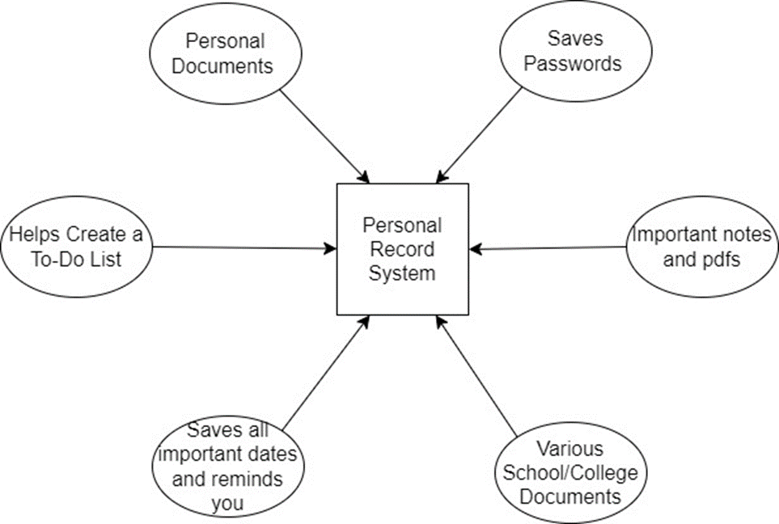
FEATURES
Creates an account which can be easily accessed by Students.
Adds all Personal Information and securely saves it with password protection.
Saves all of the student passwords that have been created for various accounts.
There is an option to keep all of your notes in the form of images and pdfs in a single folder.
Keeps all of your important documents in one place.
It may also save not only personal but also school/college documents.
Add all of the important dates and future events, and PRS will keep track of them and remind you.
It also assists you in creating and sticking to a time-based to-do list.

Slide 16
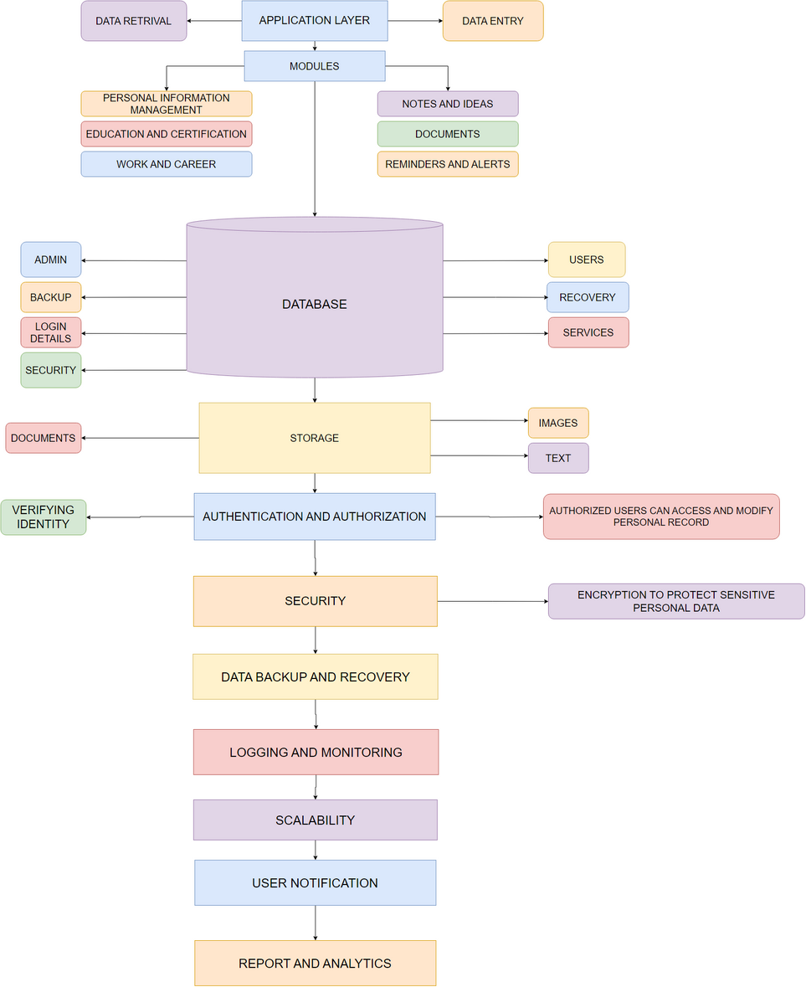
SYSTEM ARCHITECTURE

Slide 17
CONCLUSION
The project emerges as a vital and relevant solution in today’s dynamic and information-driven landscape. By providing a centralized repository for notes, documents, tasks and goals, it addresses the challenges posed by a digital clutter and organization. By offering a holistic solution to data organization, security, and accessibility , this system paves the way for enhanced success, efficiency for managing students as well as personal records.

Slide 18
THANK YOU

